Slide 1
BUSINESS TRAVEL ACCIDENT
Versiti Inc. and Subsidiaries
Policy # GTU7894220
Coverage Summary

Slide 2
Business Travel Accident Program – Overview
Provides coverage for accidents that occur while traveling worldwide for business travelers
Pays usual and customary charges for medical expenses outside of employee’s home country
Covers evacuation expenses resulting from
Governmental formal recommendation to leave country
Political, social, or military event with governmental evacuation order
Natural disasters
Confirmed physical attack
Confirmed threat of physical attack
Medical emergencies
Multilingual Customer Service Representatives are available 24 hours a day, 7 days a week, 365 days a year
Coverage for Emergency Medical Assistance
Dedicated website for international travelers
2

Slide 3
Business Travel Accident Program – Who Is Covered?
Employee Eligibility: All employees and volunteers of Versiti Inc. & Subsidiaries who are traveling on the business of, at the expense of, or volunteering on the behalf of the Policyholder.
Accidental Death and Dismemberment:
Employees Principal Sum - $200,000
Volunteers Principal Sum - $50,000
Spouse & Dependent Children Eligibility: For your Dependent spouse or domestic partner and dependent children {up to age 26 years} to be insured, they will need to be traveling with the eligible employee who is traveling at the expense of the policyholder. All coverages according to policy apply to Spouse & Dependent Children.
3

Slide 4
Business Travel Accident - Assistance Services
Emergency Medical Referrals
Medical Monitoring and Evacuation
Medical or Non-Medical Repatriation
Hospital Admissions and Medical Payments
Prescription Assistance
Visit to Hospital
Return of Child, Companion, or Remains
Passport and visa information
Weather, cultural, and exchange information
Country and City Risk Ratings/General Travel Tips
Health, Medical, and Safety Reports
Consulate Contacts
Inoculation and Immunization Requirements
Travel advisories
Security Alerts
Foreign Equivalent of 911
3

Slide 5
Out of Country Medical – Covered Expenses
Benefit Maximum: $250,000
Deductible: $0
Examples of Covered Expenses*:
Medical, surgical care, and treatment provided by a physician as a result of an accident or sickness (including Covid-19).
Emergency Dental, includes dental accident to a sound natural tooth and alleviation of sudden unexpected dental pain subject to policy maximums.
Hospital room and board charges, and intensive care unit charges, subject to policy maximums.
All medically necessary and/or required surgical services and supplies while confined in a hospital.
Outpatient medical care expenses provided by hospital or clinic. Professional local ambulance service.
* This list contains examples and is not all-inclusive. Please refer to the policy for a complete listing and information on coverage, limitations, and exclusions.
8

Slide 6
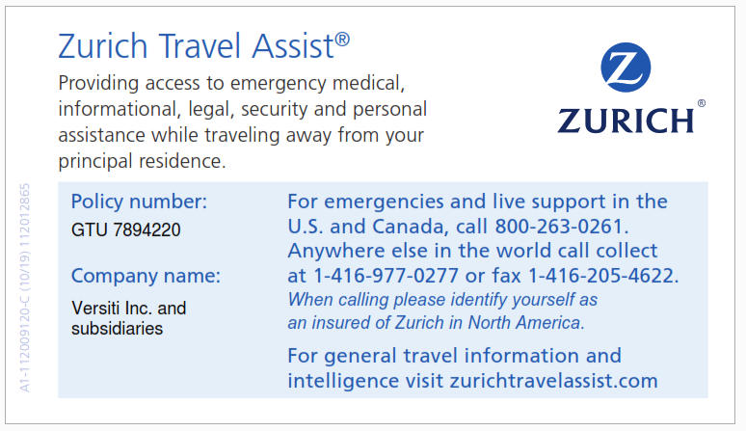
Business Travel Accident – Travel Card
At the time of any incident, please contact the Zurich Travel Assist number shown in the middle of the card to obtain prior approval for any expenses.
4

Slide 7
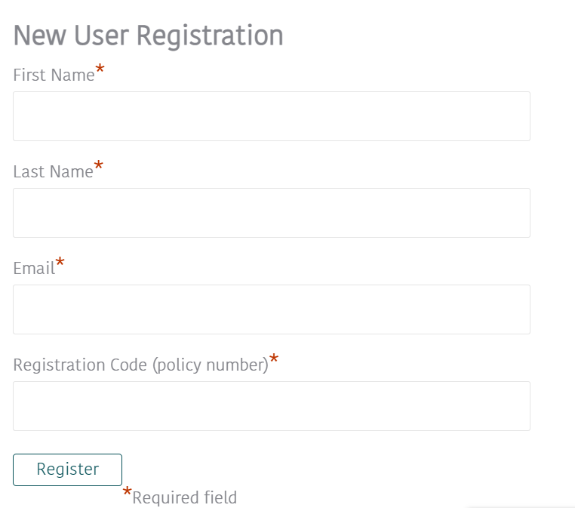
Business Travel Accident – Travel Risk Intelligence Portal
Travel Risk Intelligence Portal
Members-only website that provides access to up-to-date intelligence about events around the world that could impact your health, safety and security while traveling, along with useful tools that help minimize the inconveniences associated with international travel.
How to login:
Go to https://www.zurichtravelassist.com/
Click “travel risk & security”
Register your details
Registration code = POLICY NUMBER
5

Slide 8
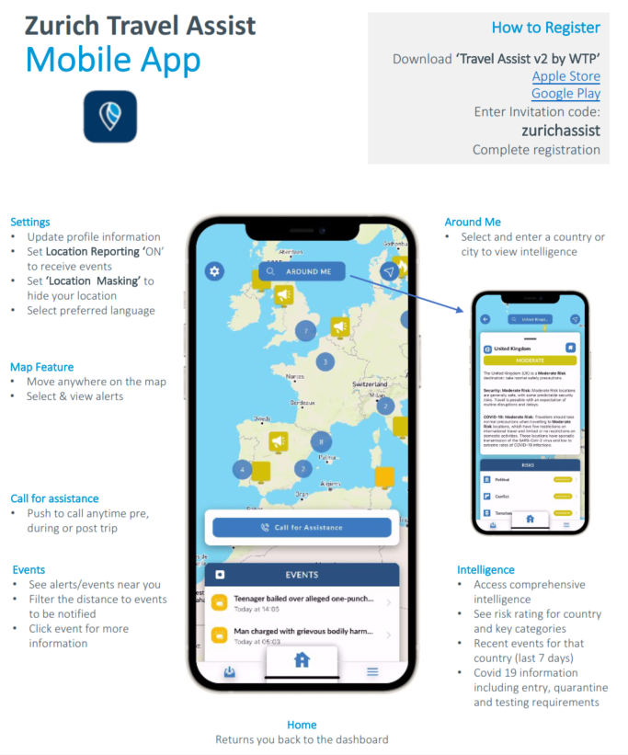
Business Travel Accident – Mobile Assist App
5

